Slide 1


Would you trust an AI Agent with your credit card?
The Trust and Security Layer for your wallet.
CHALLENGE PARTNER
Swiss {ai} Weeks 2026

Slide 2

From intent to trusted judgement.
Every purchase runs through three deterministic layers before Wallet Control returns a verdict.
USER → LLM
RULEBOOK
PURCHASE
shopping intent, in the agent’s own words
the customer’s wallet policy
the proposed transaction
1
Trust filter
Merchant, amount and timing checked against your rules.
Cost per user per year: ~ 1.50 $ with small LLM
2
Reasoning · deterministic
The same policy, evaluated the same way, every single time.
3
Fact reader
Reads the actual basket — no interpretation left to chance.
No hallucination
No prompt injection
Trusted judgement
CHALLENGE PARTNER
Swiss {ai} Weeks 2026

Slide 3
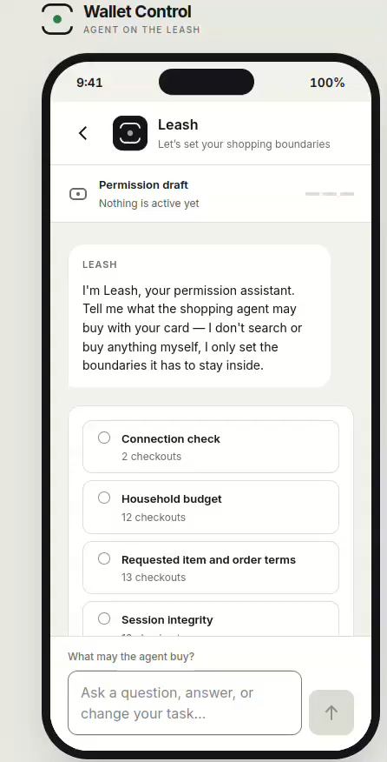
See the Demo.
CHALLENGE PARTNER
Swiss {ai} Weeks 2026

Slide 4





Meet the Team ratelimit rebels
September 2026.
Glody Figueiredo
Lukas Soukup
Razije Tairi
Romana Sookyova
Maria Briza
Nigth Shift Prompt Comander, Official AI babysitter
Software developer
Doctoratal Research DBA, Regulatory Projects
Graphic designer, Junior UX UI designer
Management & Languages
CHALLENGE PARTNER
Swiss {ai} Weeks 2026

Slide 5
Annex
CHALLENGE PARTNER
Swiss {ai} Weeks 2026

Slide 6
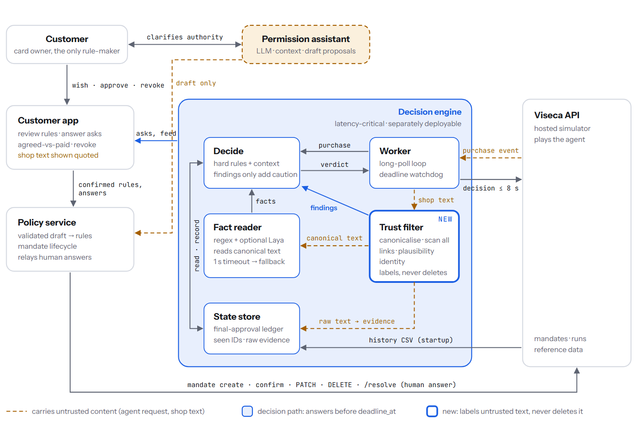
Design System
CHALLENGE PARTNER

